Slide 1
Statistics intro
It is a capital mistake to theorize before one has data. Insensibly one begins to twist facts to suit theories, instead of theories to suit facts.“
Sherlock Holmes to Dr. Watson
A Study in Scarlet
For EDUC/PSY 6600

Slide 2
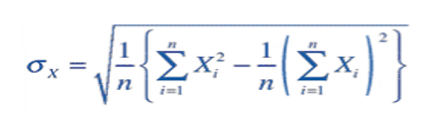
The Goal
When most of you read data analysis sections now, you probably do not understand 90% of what is written At the end of this course you will probably not believe 90% of what is written

Slide 3
What is statistics?
Branch of mathematics
Young discipline, emerging in 1920s-1930s
Problem solving
Art vs. science
Deterministic versus stochastic models

Slide 4
Basic Terminology
Population vs. Sample
Parameter vs. Statistic
Variable vs. Constant Value
Discrete vs. Continuous Data
Independent vs. Dependent Variable
Descriptive vs. Inferential Statistic

Slide 5
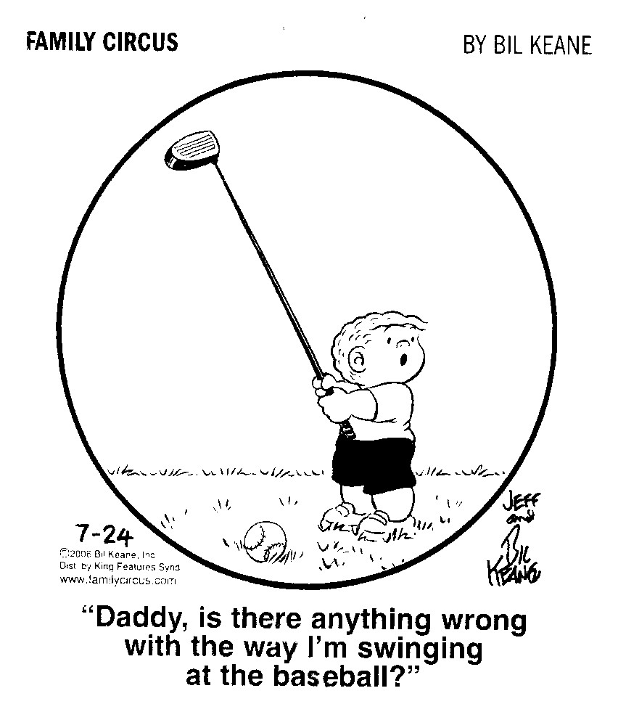
expectations
Expectations
1-2 courses only ‘tip of iceberg’
Years to master many subtleties
Right tool for the job
Software package as
workshop, analytical
methods as tools

Slide 6
expectations
“…How hard one finds it to learn something is a function of:
the intrinsic difficulty of the thing,
the person’s previous experience,
preferred modes of thinking,
etc., and
how learning is approached.”
-John Fox, PhD

Slide 7
Scientific method
Research Problem → Numerical Form
Statistical methods apply to samples
Infer what’s occurring in population from sample
However, statistical methods only describe what is occurring within data set
Inference based on logical judgment of results of statistical analyses and strength of study design
Statistics cannot ‘make-up’ for poor study design (garbage in, garbage out)

Slide 8
Issues in study design
Trade-off between internal and external validity
Validity lies on continuum, rather than yes-no
Samples should be…
Large enough to limit random error & provide power
Representative enough to…
Limit systematic error (bias): Internal validity
Offer generalizability: External validity
Obtainable given time and cost

Slide 9
Sample selection
Specify well-defined target population
Sample is subset of target population
Define inclusion/exclusion criteria in Methods
Inclusion criteria: 1⁰ characteristics of target pop.
Specification of demo. characteristics, disease status, etc.
Limits threats to internal validity
Exclusion criteria: Characteristics threaten data quality
Use sparingly: Ultra-specific sample ↓ generalizability

Slide 10
sampling
Many cases meet inclusion/exclusion criteria
Sampling unit: Basic unit around which a sampling procedure is planned
Individuals, animals, households, classrooms, neighborhoods
Sampling frame: List of ALL possible units in pop.
Sample: Units chosen from eligible pop.

Slide 11
sampling
Non-probability sampling:
↑ risk of bias
Convenience sampling
Purposive or judgmental sampling
Quota sampling
Probability (random) sampling:
↓ risk of bias &↑ likelihood results can be replicated
Simple random sampling
Systematic sampling
Stratified random sampling
Cluster sampling

Slide 12
sampling
Descriptive and inferential statistics based on laws of probability
Laws of probability apply to random events
Random events → Random sampling
Measurements from random sample → Random variable

Slide 13
Supplemental slides – types of sampling

Slide 14
Non-Probability Sampling
In most research, probability sampling is not practical, possible, or even ethical
Subjective judgment as to whether convenience sample represents target population
For given research question, would conclusions be similar if a true probability sample was obtained?
Burden is on researcher

Slide 15
Convenience sampling
Non-random, cases selected due to ‘convenience’
As they appear or agree to participate
Every unit meeting criteria selected for study
Easily accessible in terms of costs and logistics

Slide 16
Purposive or judgmental sampling
Sample selected on basis of investigator’s knowledge of target population
Used when shown that a certain subset is representative of target population
Often used for pretest or pilot study
Specific disease, behavioral, or educational states
Reliance on available subjects
e.g., survey every student enrolled in a large class

Slide 17
Quota sampling
Proportions in population are reflected in sample
Used to obtain a representative sample
Cases meeting study inclusion/exclusion criteria enrolled to ‘fill’ quotas
Sometimes randomly, sometimes not

Slide 18
Simple random sampling
Sampling units
Known and equal (non-zero) probability of selection
Assigned a number
Selected by random process (computer)
Simple to do, but requires knowledge and access to complete sampling frame in advance
Generally sampling WITHOUT replacement

Slide 19
Systematic sampling
Units are sampled via periodic, consistent process
e.g., selecting every 4th patient admitted to clinic
Randomly select starting point
If end is reached, consider sampling frame as circular
Rarely better choice than simple random sampling
Disadvantages
Cyclical sampling may lead to consistent highs, lows, or lack of variability (periodicity), or duplicates
Researchers may predict cases to be enrolled, manipulate inclusion/exclusion

Slide 20
Stratified random sampling
Attempt to...
Obtain more representative sample
Ensure sampling of less frequent cases
Achieve more precise estimates of population parameters
Target population divided into strata/subgroups with common characteristics
e.g., sex, race, age, educational groups
Simple random sampling applied within each stratum
Use only 3-10 strata: Negligible improvement in precision thereafter

Slide 21
Cluster Sampling
Entire groups of naturally occurring units selected via simple random sampling
e.g., classrooms, schools, clinics, sports teams, neighborhoods, work crews
All individual units within cluster are measured
Use when impossible/impractical to…
Obtain exhaustive list of all sampling units
Sample individuals from sampling frame
Clusters should be as similar as possible
Units within clusters tend to be more homogeneous than units drawn from simple random sampling

Slide 22
Multi-stage or 2-stage cluster sampling
1st stage: Primary sampling unit (PSU)
Clusters are sampled randomly
2nd stage: Secondary sampling units (SSU)
Individuals are sampled randomly within each cluster
More than 2 stages possible
School districts → schools → classrooms/teachers → students
Potential loss in accuracy, sampling error at each stage
Cluster sampling adds complexity to data analysis

